Slide 1
Spanning Tree Protocol (STP)
Loop Prevention in Layer 2 Networks

Slide 2
Basic Communication in Networks
Devices need MAC address
Broadcast request (ARP)
Switch forwards to all devices

Slide 3
Broadcast in Simple Network
Single switch
Controlled broadcast
Normal communication

Slide 4
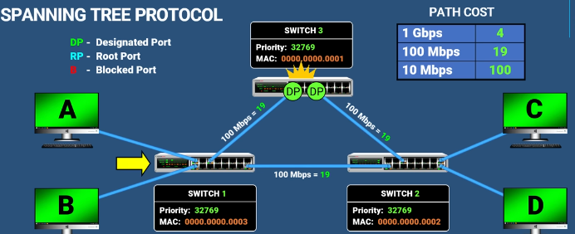
Problem in Multi-Switch Network
Multiple switches
Broadcast loops
Infinite circulation

Slide 5
Broadcast Loop Issue
Broadcast storm
Network congestion
MAC instability

Slide 6
How STP Solves It
Blocks certain ports
Creates loop-free topology

Slide 7
Root Bridge Selection
Switches exchange BPDUs
Elect root bridge

Slide 8
Bridge ID (BID)
Priority + VLAN + MAC
Default: 32768 + VLAN

Slide 9
Root Bridge Election
Lowest BID wins
If same → lowest MAC

Slide 10
Designated Ports
On root bridge
Always forwarding

Slide 11
Root Ports
On non-root switches
Lowest path cost

Slide 12
Path Cost
1Gbps=4
100Mbps=19
10Mbps=100

Slide 13
Blocked Ports
Higher cost or BID
Prevent loops

Slide 14
Final Result
Loop-free network
Active + backup paths

Slide 15
Conclusion
STP prevents loops
Uses BPDUs
Ensures stability

Slide 16
Security Perspective
BPDU spoofing
Attacker becomes root
MITM risk

